Slide 1
Welcome to Asian American Studies
AAS 152:
Asian American Literary and
Popular Culture: Race, Fantasy, Futures
Professor Leslie Bow
TAs: Mojca Penca and Nabiha Mansoor
--Take a moment and identify your section #
--Phones off
Today: Course overview,
Syllabus, reader, and course documents on CANVAS

Slide 2
Professor Leslie Bow
English and Asian American Studies
Contact and Online Office Hours:
[and section 301]
lbow@wisc.edu
Office Hours: NOTE Change from syllabus
Mon. 12:30-1:30 and Wed. 2:30-3:30pm
7179 HC White Hall
mailbox: 7th Fl. HC White Hall

Slide 3
The Arrival Shaun Tan

Slide 4
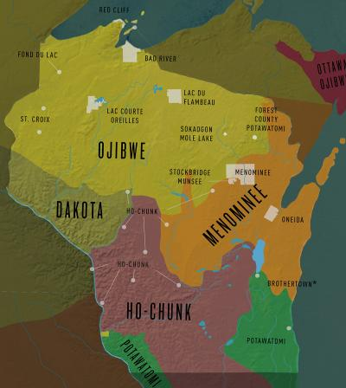

Slide 5
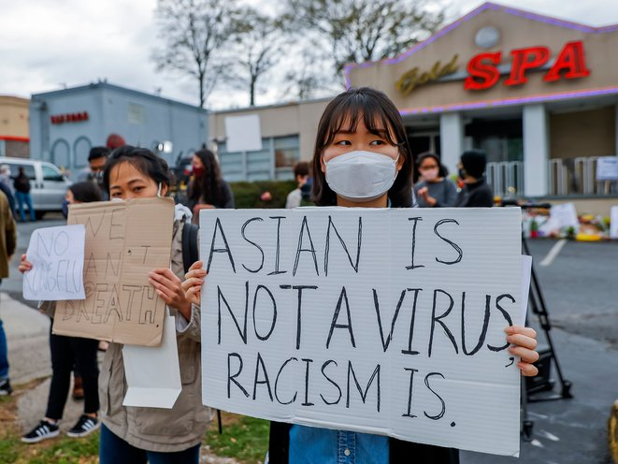

Slide 6

Okuni, Cars 2 Disney/Pixar 2011 Is this Japanese car adorable? Or do you find this image troubling?

Slide 7
Required texts to purchase: available at University bookstore and online
American Born Chinese, Gene Luen Yang
M. Butterfly*, David Henry Hwang [note edition]
Shortcomings, Adrian Tomine
The Arrival, Shaun Tan
To Download the course reader [printing recommended] and bring to section:
1. Go to Modules and click on the readings for the week
or
2. Recommended: Select reader-all from Canvas Files choose Files, scroll to “reader-all” at the 3 dots on the right choose: Download folder

Slide 8

Why the Asian food fetish?
How do Asian Americans see Asian food differently? Or do they?

Slide 9

On racialization:
Who we “are” vs. how we “appear” to others . . .

Slide 10





Purchase early edition, M. Butterfly*
NOT this one
Any of these editions

Slide 11
race fetishism vs. having a type?

Slide 12


Popular culture and globalization

Slide 13
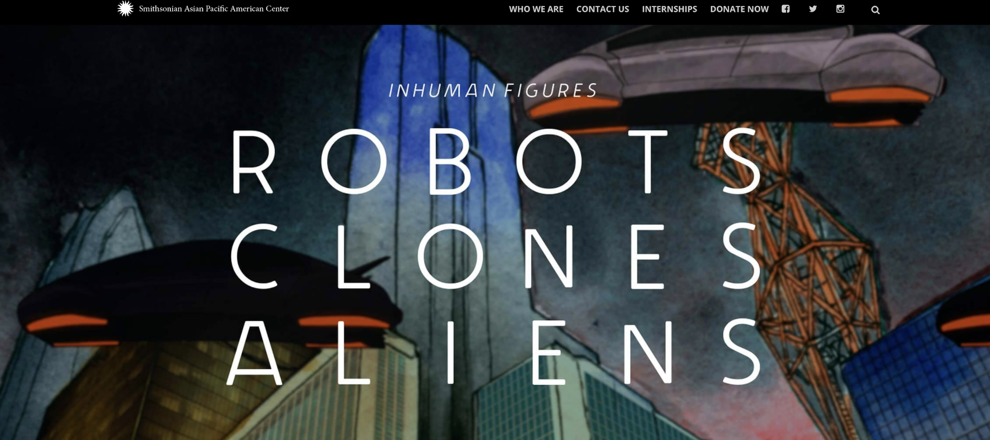
Asian Americans and Sci fi

Slide 14
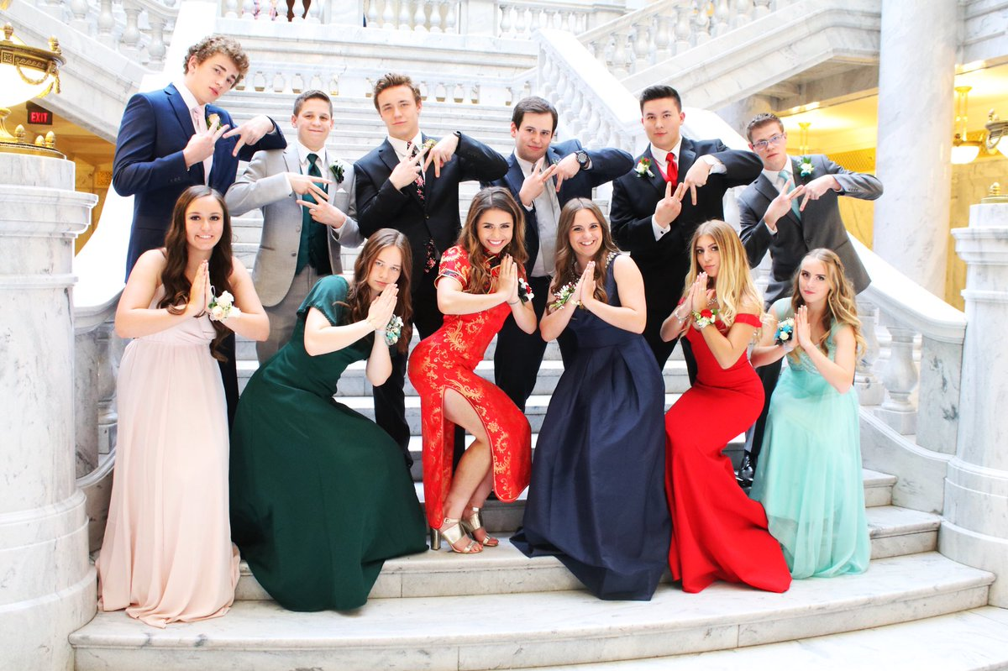
What’s wrong with this picture? Content alert. Confronting controversy intellectually, civilly

Slide 15
Sections
Check your section assignment
Make note of your color assignment for Monday’s lecture sign-in
Leslie (W after this lecture) 301: clouds
Mojca: sections TR and F:
302 grey; 306 light blue; 307 green; 310 lavender
Nabiha: sections TR and F
303 ; 304 yellow; 308 orange; 309 pink

Slide 16
To do list for this week:
Upload your photo to your profile on Canvas and turn on your Announcements settings
Purchase the books
Download the reader-all from Canvas Files [printing recommended]: choose Files, scroll to “reader-all” at the 3 dots on the right choose: Download
Post a self-introduction on your Canvas section discussion group for Week 1 by Friday 5pm.
Read the introductions of others in your section by Wed. and feel free to post an Optional reply or welcome.
and
Start the readings on the syllabus for Week 2

Slide 17
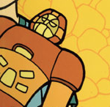
Questions about course content, accessing content, or procedures?

Slide 18
Read by Monday from the reader on Canvas in Weekly Modules: links to article reading by week [or in Files; search by author’s name or title]
By Mon: “Legacies of Discrimination,” Angelo Ancheta
“Persistence of Yellow Peril Discourse,” Ono and Pham
“How ‘Crazy Rich’ Asians Have Led to the Largest Income Gap in the U.S.,” Hassan and Carlsen
By Wed: “Symbolic Capital and Stereotype Promise,” Lee and Zhou
and
View Media:
“A Conversation with Asian-Americans on Race,” Gandbhir and Stephen
Enrollment issues? Email: jessica.montez@wisc.edu 303 Ingraham

Slide 19
BRING the reading to section!!! To think about for next week’s reading:
--If “Asia” is the world’s most populous region, why are Asian Americans only 5.6 % of the US population?
-- Think about the reach of history:
Does the Asian American history depicted in Ancheta’s “Legacies of Discrimination” shed light on how your family was affected by U.S. immigration and naturalization laws? Select the passage that reflects how you or your family came to the U.S.
Or: Unless you are indigenous to North America, your family’s presence here reflects a larger historical pattern of immigration. What is it?

